Slide 1
Module 2
Preparing Data for Analysis

Slide 2
Outline
Introduction to module
Locating and downloading datasets
Datasets and files
Data sources
Data preprocessing
Importance of data preprocessing
Data preprocessing tasks
Missing values
Replacing missing values
Normalizing and discretizing data
Data normalization
Discretization
Data reduction
Feature selection
Data sampling
Introduction to R language
Principles of R
Working with R
Data preprocessing with R

Slide 3
Learning Objectives
Locate and download files for data analysis involving genes and medicine.
Open files and preprocess data using R language.
Write R scripts to replace missing values, normalize data, discretize data, and sample data.

Slide 4
Introduction to Module
This module focuses on locating, downloading, and preprocessing data to prepare it for Big Data analytics.
Data are stored in files located on computers either on a personal, server, or cloud-based computer.
In order to analyze these data, they are loaded in the main memory of a computer in containers called variables.
These data are preprocessed to remedy some of their defects, such as missing values, noisy values, values of different ranges, or to change data types.
The R programming language provides ready to use functions to download files, read them, and preprocess them.
We provide in this course a cloud-based infrastructure to analyze Big Data without having to install the environment locally. All analyzes can be performed from a Web-browser.

Slide 5
Outline
Introduction to module
Locating and downloading datasets
Datasets and files
Data sources
Data preprocessing
Importance of data preprocessing
Data preprocessing tasks
Missing values
Replacing missing values
Normalizing and discretizing data
Data normalization
Discretization
Data reduction
Feature selection
Data sampling
Introduction to R language
Principles of R
Working with R
Data preprocessing with R

Slide 6
Locating and Downloading Datasets
In general, we are interested in
any element capable of decreasing or increasing the uncertainty of a system
Change in the state of « uncertainty" in a system
=
Information

Slide 7
Locating and Downloading Datasets
A piece of information is some knowledge, some data processed so that it modifies the state of « uncertainty » about a system
Data
Processing
Information

Slide 8
Locating and Downloading Datasets
Second viewpoint :
The different dimensions of « lnformation »

Slide 9
Locating and Downloading Datasets
First
dimension
Technical Dimension
A stored or transmitted symbol
=
« The data"

Slide 10
Locating and Downloading Datasets
Semantic Dimension
The meaning, the knowledge represented
Second
dimension
=
« The Information »
B. Lussato in « Theories about information and the human brain processor «
« A message is a set of data which will only become information when the message is received and understood »

Slide 11
Locating and Downloading Datasets
Third
dimension
The utility of information
Does information transform the representation of knowledge ?
=

Slide 12
Locating and Downloading Datasets
=
+
Information
Datum
Semantic dimension
=>
A change in the representation of knowledge
& /or
Which modifies the state of certainty about a system

Slide 13
Locating and Downloading Datasets
Photocopy of the price of an article
=
Technical Dimension –
Data
Is the photocopy
readable ?
Do the symbols present on the photocopy have a meaning ?
Semantic Dimension – Information
=

Slide 14
Locating and Downloading Datasets
Third dimension :
Utility of the information
For who knows the price of this article, these symbols do not modify the state of certainty about the system
=
The symbols are not information
For who does not know the price of an article, these symbols do modify the state of certainty about the system
These symbols are information
=

Slide 15
Outline
Introduction to module
Locating and downloading datasets
Datasets and files
Data sources
Data preprocessing
Importance of data preprocessing
Data preprocessing tasks
Missing values
Replacing missing values
Normalizing and discretizing data
Data normalization
Discretization
Data reduction
Feature selection
Data sampling
Introduction to R language
Principles of R
Working with R
Data preprocessing with R

Slide 16
Datasets and Files
Tranforming Data into Information Variables, Datasets, and Databases

Slide 17
Datasets and Files
Data are collected in datasets that can be stored in
Variables – containers used by programming languages to store data (Ex: a cell in an Excel spreadsheet). Not persistent – turning off the computer loses the data.
Files - sets of data meant to store them on digital media (Ex: an Excel spreadsheet). Persistent – are preserved when the computer is turned off.
Databases – shared collection of logically related data (and a description of these data) recorded or stored on digital media designed to meet the information needs of an organization. Persistent.

Slide 18
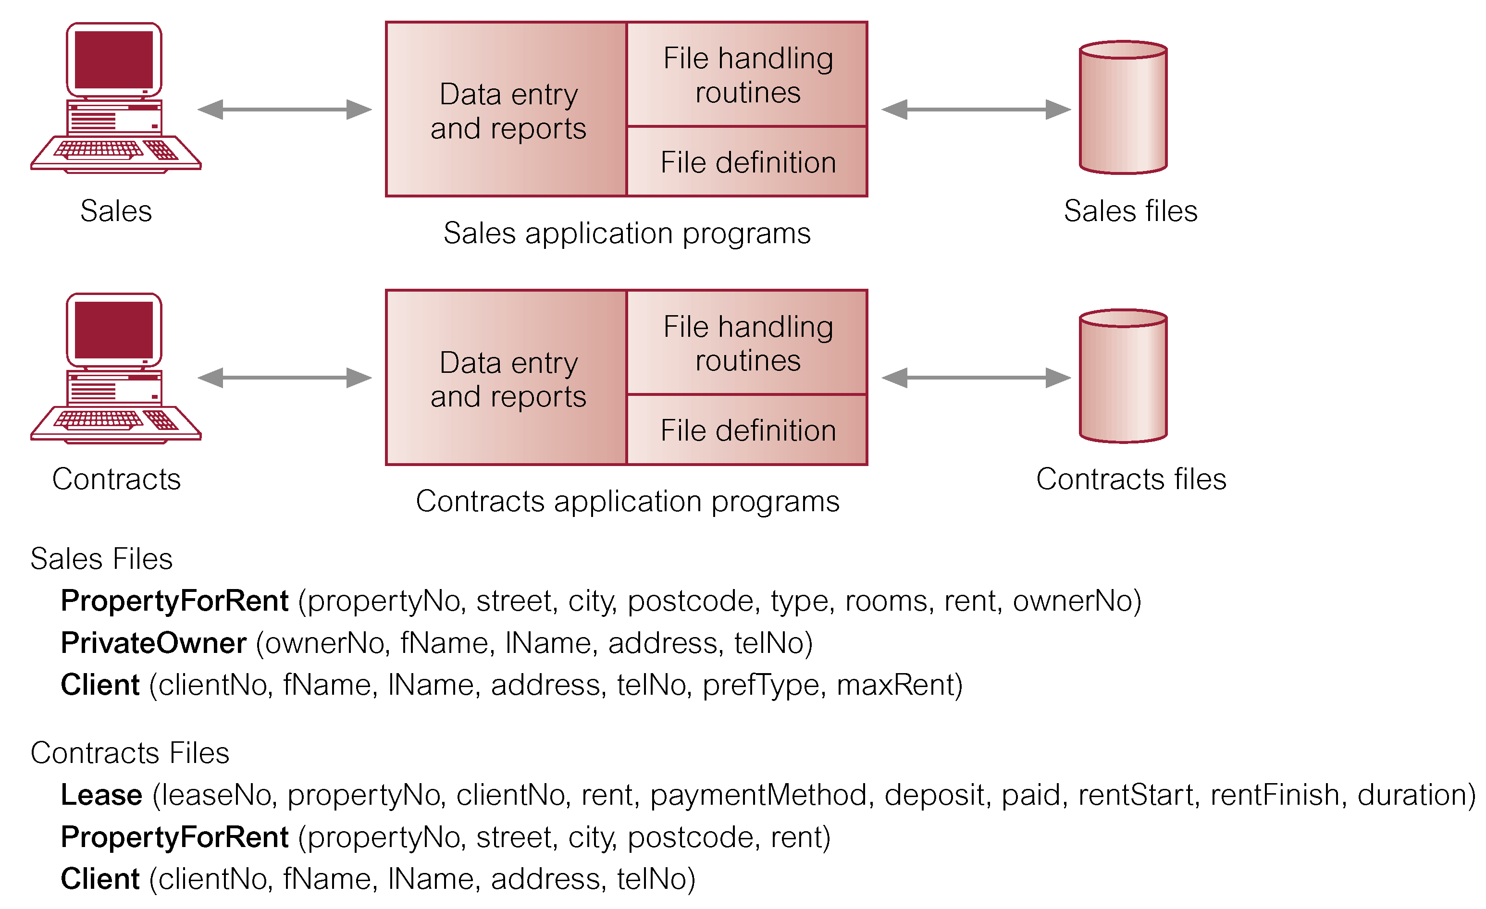
Datasets and Files
Data are stored in files, organized in variables.
from Connolly and Begg (2014)

Slide 19
Datasets and Files
Data in a file is generally organized like in a spreadsheet.
FILE « CLIENT"
Client No = Unique identifier

Slide 20
Datasets and Files
Data in a file is generally organized in columns and rows.
A column corresponds to a variable – also called attribute, feature, field, or simply column.
A column has a name.
A row stores the set of values for each variable for a particular sample or instance.
A sample corresponds to an individual, person, patient, object, or other entity.
See example on previous slide.

Slide 21
Datasets and Files
Files can have many formats.
One of the most useful formats is a text delimited file:
It can be imported in Excel or database management software.
The suffix can be .txt or .csv.
Each variable is separated by a character called a delimiter, such as a comma, a tab, a semi-colon etc.
The first row may or may not contain the list of variables in the file, separated by the delimiter.
Each additional row contains the values associated with the corresponding variable for a particular sample.

Slide 22
Datasets and Files
client.csv file example (with delimiter “, “)
clientNo, fName, lName, address, telNo
1, Lisa, Smith, mountain, 1439
2, John, Mack, city, 5634
3, Mary, Lewis, river, 9045
4, Mark, Trump, plain, 2710
5, Leslie, Clinton, village, 3592

Slide 23
Outline
Introduction to module
Locating and downloading datasets
Datasets and files
Data sources
Data preprocessing
Importance of data preprocessing
Data preprocessing tasks
Missing values
Replacing missing values
Normalizing and discretizing data
Data normalization
Discretization
Data reduction
Feature selection
Data sampling
Introduction to R language
Principles of R
Working with R
Data preprocessing with R

Slide 24
Data Sources
Where do we find biomedical Big Data sources ?
Data in existing repositories (proprietary):
Electronic Medical Records (EMRs).
Clinical studies.
Open data sources (public).
List in resources
The Cancer Genome Atlas (TCGA)
Alzheimer’s Disease Neuroimaging Initiative (ADNI)
Health and Retirement Study (HRS)
UK Biobank
Millennium Cohort Study
CALIBER (EHR and admin data)
UCI Machine Learning Repository
…

Slide 25
Data Sources
Heterogeneous types of Big Data to analyze separately or together:
Numeric, nominal.
Text.
Image.
Video.
Sound.
Social media.
Web.
Time series.
Signal.
…

Slide 26
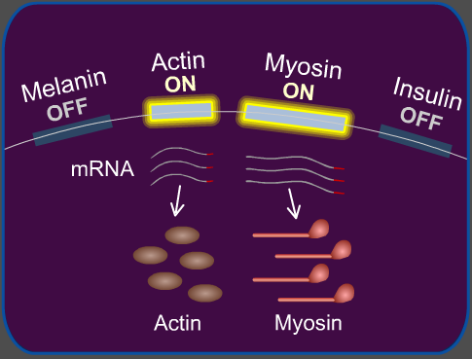
Data Sources
Gene expression data.
http://learn.genetics.utah.edu/content/labs/microarray/

Slide 27
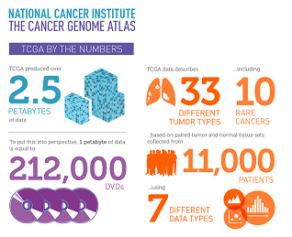
Data Sources
TCGA data
The cancer Genome Atlas (TCGA) provides multi-dimensional data about 33 types of cancers.
It provides 2.5 petabytes of data from over 11,000 patients including both tumor tissue and matched normal tissue.
For each type of cancer, several datasets are available with 7 different types of data – many being public, others requiring authorization to be accessed.

Slide 28
Data Sources
Broad Institute
TCGA provides data at the patient level. Each patient in a separate file.
The Broad Institute from Harvard, a famous bioinformatics research center, provides merged datasets from TCGA data in its Firehose Web-site (http://gdac.broadinstitute.org/).

Slide 29
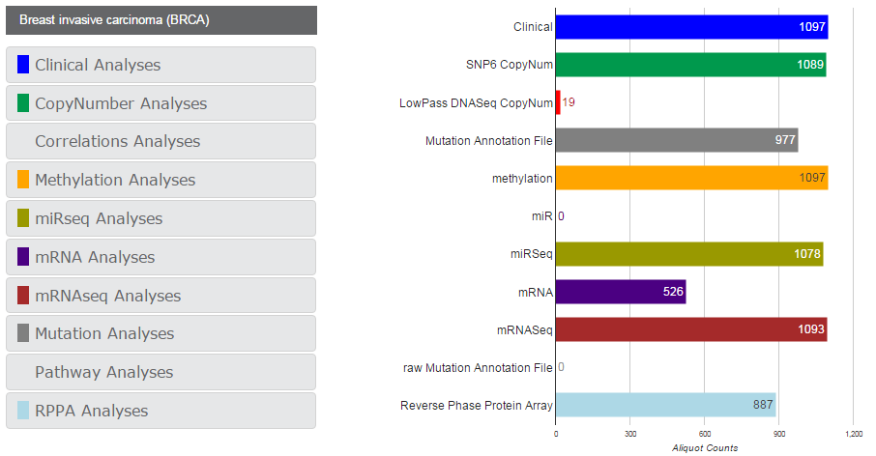
Data Sources

Slide 30
Data Sources
Microarray
A microarray contains a set of measurements of gene expressions (mRNA – other types of RNA are said to be non coding).
Nucleus contains between 2,000 and 60,000 protein-coding genes, only a subset being expressed at a certain point in time in the form of mRNA.
A microarray is a solid support on which DNA of known sequence is deposited in a regular grid-like manner (cDNA).

Slide 31
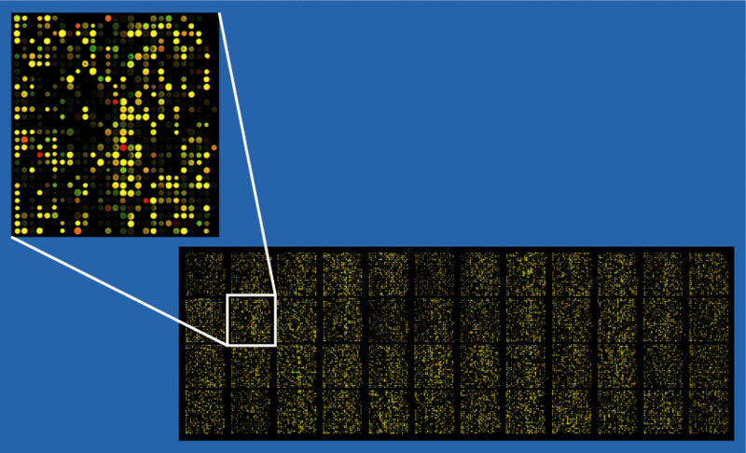
Data Sources
40,000 probe microarray example
(from Wikipedia)

Slide 32
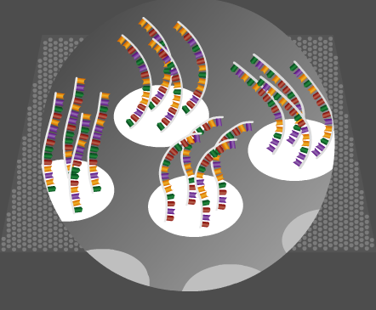
Data Sources
Microarray
Following, RNA (mostly mRNA labeled with fluorescence) extracted from interesting biological sources of interest is hybridized to the array.
Image analysis and data analysis are used to determine the quantity of RNA associated to each cell in the microarray.

Slide 33
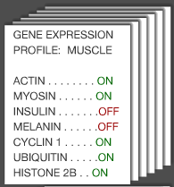
Data Sources
Microarray
Interpretation follows the identification of mRNA levels, however there is a weak correlation between mRNA and protein levels.
Data consist in a list of attributes corresponding to genes and their values corresponding to expression level.

Slide 34
Data Sources
RNA seq
A more advanced method for quantifying gene expressions.
Part of Next Generation Sequencing (NGS) methods – microarray being the first generation.
Methods based on synthesis chemistry of individual nucleotides performed in massively parallel form.
Generates vast amounts of data.
Affords for much higher sensitivity than previous methods.

Slide 35
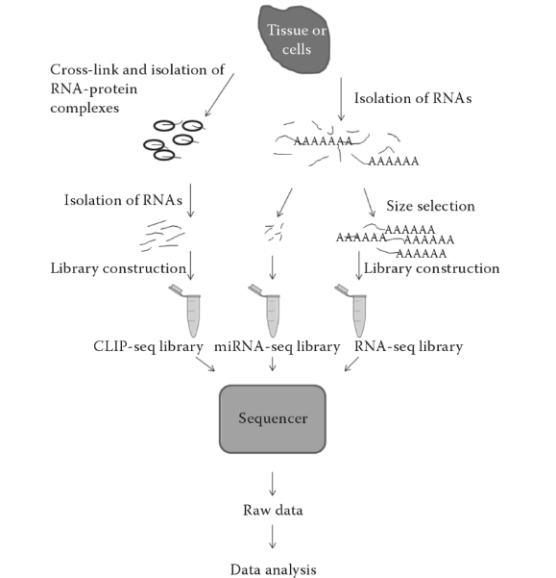
Data Sources
from Korpelainen et al. (2015)

Slide 36
Outline
Introduction to module
Locating and downloading datasets
Datasets and files
Data sources
Data preprocessing
Importance of data preprocessing
Data preprocessing tasks
Missing values
Replacing missing values
Normalizing and discretizing data
Data normalization
Discretization
Data reduction
Feature selection
Data sampling
Introduction to R language
Principles of R
Working with R
Data preprocessing with R

Slide 37
Data Preprocessing
Before preprocessing data, data analysts first want to understand their data, using statistical techniques and visualization.
They want to first get a sense of the data quality and major characteristics such as central tendency (mean, median, standard deviation, mode etc. – see definitions under Resources for this module), distribution (histogram, scatter plots, etc.).
Data preprocessing represents the first step in actual data analytics and aims at making sure that data is ready to be analyzed.

Slide 38
Outline
Introduction to module
Locating and downloading datasets
Datasets and files
Data sources
Data preprocessing
Importance of data preprocessing
Data preprocessing tasks
Missing values
Replacing missing values
Normalizing and discretizing data
Data normalization
Discretization
Data reduction
Feature selection
Data sampling
Introduction to R language
Principles of R
Working with R
Data preprocessing with R

Slide 39
Importance of Data Preprocessing
Data as found in public datasets and other types of datasets is imperfect, ‘dirty’.
Data quality is essential to get good analytics results - Garbage In, Garbage Out (GIGO).
The format of data often requires to make changes – for example the analytical method used may required nominal data, while your data is numeric.

Slide 40
Importance of Data Preprocessing
Types of data characteristics to fix:
Missing values
Noisy data
Incorrect data type
Incomplete data

Slide 41
Importance of Data Preprocessing
The goal is to improve the quality of data to ensure that the measurements provided are as
Accurate
Precise
Complete
Interpretable
Correct
as possible.

Slide 42
Outline
Introduction to module
Locating and downloading datasets
Datasets and files
Data sources
Data preprocessing
Importance of data preprocessing
Data preprocessing tasks
Missing values
Replacing missing values
Normalizing and discretizing data
Data normalization
Discretization
Data reduction
Feature selection
Data sampling
Introduction to R language
Principles of R
Working with R
Data preprocessing with R

Slide 43
Data Preprocessing Tasks
Data preprocessing involves several tasks
Data cleaning
Dealing with missing values
Dealing with erroneous data and outliers
Data transformation
Changing data types (discretization)
Changing range of data values (normalization)
Adding variables
Data reduction
Feature selection
Sampling

Slide 44
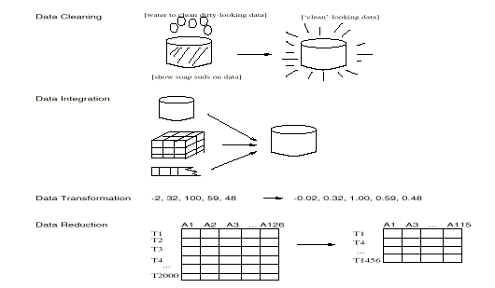
Data Preprocessing Tasks
from Han and Kamber (2014)

Slide 45
Outline
Introduction to module
Locating and downloading datasets
Datasets and files
Data sources
Data preprocessing
Importance of data preprocessing
Data preprocessing tasks
Missing values
Replacing missing values
Normalizing and discretizing data
Data normalization
Discretization
Data reduction
Feature selection
Data sampling
Introduction to R language
Principles of R
Working with R
Data preprocessing with R

Slide 46
Missing Values
Missing values can appear in your dataset as
A blank
A ‘.’
A ‘n/a’
A ‘?’
There are several strategies to deal with them, for example applying some kind of filter.

Slide 47
Outline
Introduction to module
Locating and downloading datasets
Datasets and files
Data sources
Data preprocessing
Importance of data preprocessing
Data preprocessing tasks
Missing values
Replacing missing values
Normalizing and discretizing data
Data normalization
Discretization
Data reduction
Feature selection
Data sampling
Introduction to R language
Principles of R
Working with R
Data preprocessing with R

Slide 48
Replacing Missing Values
Strategies for replacing missing values
Delete the entire row (depends on how many rows you have)
Replace by a fixed value (‘unknown’)
Replace values by a statistic associated with a particular column or a particular group – mean, median, mode
Replace values based on nearest neighbors
Replace values based on likelihood.

Slide 49
Replacing Missing Values
Handling missing values
Data deletion
Delete entire row
Delete entire column
Data imputation
Impute a constant value
Impute with mean …
Impute from neighbors
Impute based on a model
Impute randomly

Slide 50
Outline
Introduction to module
Locating and downloading datasets
Datasets and files
Data sources
Data preprocessing
Importance of data preprocessing
Data preprocessing tasks
Missing values
Replacing missing values
Normalizing and discretizing data
Data normalization
Discretization
Data reduction
Feature selection
Data sampling
Introduction to R language
Principles of R
Working with R
Data preprocessing with R

Slide 51
Normalizing and Discretizing Data
In order to handle noise in the data, they can be transformed globally to
Reduce the grain in the data (discretize) from fine-rain to higher-grain, for example from numeric to nominal.
Change the scale or range of the data (normalize).
It might also be necessary to discretize to apply different data analytics methods because some prediction methods require a nominal target attribute.

Slide 52
Outline
Introduction to module
Locating and downloading datasets
Datasets and files
Data sources
Data preprocessing
Importance of data preprocessing
Data preprocessing tasks
Missing values
Replacing missing values
Normalizing and discretizing data
Data normalization
Discretization
Data reduction
Feature selection
Data sampling
Introduction to R language
Principles of R
Working with R
Data preprocessing with R

Slide 53
Data Normalization
Normalization consists changing the scale in the data.
When having data of mixed scale, some data analytics methods do not behave well (Ex: age and income have widely different ranges).
For example, it is frequent to scale all data between the range [-1, 1] or [0, 1].

Slide 54
Data Normalization
Generally, data are scaled into a smaller range.
Methods include:
Min-max normalization
Z-score normalization
Decimal scaling

Slide 55
Data Normalization
Min-max normalization transforms data from range [m, M] into range [m’, M’] using the formula val’ = (val – m) / (M – m) * (M’ – m’) + m’
Example: normalizing into [0, 1] age values between [0, 150] age 50 → 0.33 (intuitively) check val’ = (50 – 0) / (150 – 0) * (1 – 0) + 0 = 50 / 150 = 1/3 = 0.33

Slide 56
Data Normalization
Z-score normalization val’ = val – mean / std
Ex: normalizing age values between [0, 150] where mean age in the population is 36.8 and standard deviation is 12 age = 50 → val’ = 50 – 36.8 / 12 = 1.1

Slide 57
Data Normalization
The normal (distribution) curve
From μ–σ to μ+σ: contains about 68% of the measurements (μ: mean, σ: standard deviation)
From μ–2σ to μ+2σ: contains about 95% of it
From μ–3σ to μ+3σ: contains about 99.7% of it

Slide 58
Data Normalization
Decimal scaling val’ = val / 10^{n} where n is determined such as the largest val’ would be less than 1 this formula transforms the values into interval [-1, 1] is there are negative values, and into [0, 1] otherwise.
Ex: normalizing age values between [0, 150] we want the highest age to be less than 1, therefore divide by 1,000 = 10³ age = 50 → val’ = 50 / 10³ = 0.05

Slide 59
Data Normalization
Comparison between the methods
The method that preserves the original data distribution is decimal scaling, therefore it preserves more than the others the shape of the data repartition. It acts similarly to image resizing in photo editing software (shrink / magnify).
Z-score normalization is the most used because the resulting distribution is going to be normal, which is advantageous with certain statistical methods. However it distorts the natural shape of the data distribution.
Min-max normalization can accommodate any new range we want, not only [0, 1] and [-1, 1] like the other ones.

Slide 60
Outline
Introduction to module
Locating and downloading datasets
Datasets and files
Data sources
Data preprocessing
Importance of data preprocessing
Data preprocessing tasks
Missing values
Replacing missing values
Normalizing and discretizing data
Data normalization
Discretization
Data reduction
Feature selection
Data sampling
Introduction to R language
Principles of R
Working with R
Data preprocessing with R

Slide 61
Discretization
Discretization transforms data from numeric into nominal data type.
Effects of discretization:
Smooths data.
Reduces noise.
Reduces data size.
Enables specific methods using nominal data.

Slide 62
Discretization
Discretization methods
Manual methods:
Distribution analysis.
Automatic methods:
Binning.
Equal-width binning
Equal-depth binning
Regression analysis.
Cluster analysis.
Natural partitioning.

Slide 63
Discretization
Equal-width binning
Given a range of values [min, max], we divide in intervals of approximately same width; either we set the width arbitrarily to w, or we set the desired number of bins to n, in which case w is calculated as: w = max – min / n
Ex: if the range is [0, 100] and we want 4 bins, each bin will have a width of 100 – 0 / 4 = 25 the bins will be: [0, 24], [25, 49], [50, 74], [75, 100].

Slide 64
Discretization
Equal-depth binning
Given a range of values [min, max], we place approximately the same number of instances in each bin by dividing the total number of samples nb by the desired number of samples in each bin (depth) d, in which case the number of bins n is calculated as: n = nb / d
Ex: if the range is [0, 100] for 100 samples of different values (for example 99 is missing), we want 20 samples in each bin, the number of bins will be: 100 / 20 = 5 the bins will be: [0, 19], [20, 39], [40, 59], [60, 79], [80, 100].

Slide 65
Discretization
Advantage of each method:
Equal-width binning is more simple however very sensitive to outliers in the data.
Equal-depth binning scales well by keeping the distribution of the data however the bin values may be more difficult to interpret.
Smoothing of data can be accomplished by replacing the values in a bin by statistic such as average (numeric data), median (numeric data), or mode (categorical data).

Slide 66
Outline
Introduction to module
Locating and downloading datasets
Datasets and files
Data sources
Data preprocessing
Importance of data preprocessing
Data preprocessing tasks
Missing values
Replacing missing values
Normalizing and discretizing data
Data normalization
Discretization
Data reduction
Feature selection
Data sampling
Introduction to R language
Principles of R
Working with R
Data preprocessing with R

Slide 67
Data Reduction
Data reduction can take several forms:
Feature selection.
Sampling.
Data compression.
Data aggregation.
etc.

Slide 68
Outline
Introduction to module
Locating and downloading datasets
Datasets and files
Data sources
Data preprocessing
Importance of data preprocessing
Data preprocessing tasks
Missing values
Replacing missing values
Normalizing and discretizing data
Data normalization
Discretization
Data reduction
Feature selection
Data sampling
Introduction to R language
Principles of R
Working with R
Data preprocessing with R

Slide 69
Feature Selection
Feature selection is also called dimensionality reduction.
A feature is also called a variable (or a column).
It is very important in biomedical data due to an often large number of features available – the curse of dimensionality (Ex: number of gene expressions).
It will be studied in a future module.

Slide 70
Outline
Introduction to module
Locating and downloading datasets
Datasets and files
Data sources
Data preprocessing
Importance of data preprocessing
Data preprocessing tasks
Missing values
Replacing missing values
Normalizing and discretizing data
Data normalization
Discretization
Data reduction
Feature selection
Data sampling
Introduction to R language
Principles of R
Working with R
Data preprocessing with R

Slide 71
Data Sampling
Data sampling refers to creating a subset or sample of the complete dataset.
The sample needs to be representative.
Main methods:
Simple random sampling with replacement.
Simple random sampling without replacement.
Stratified sampling.

Slide 72
Data Sampling
SRSWOR
(simple random
sample without
replacement)
from Han and Kamber (2014)
SRSWR
Raw Data

Slide 73
Outline
Introduction to module
Locating and downloading datasets
Datasets and files
Data sources
Data preprocessing
Importance of data preprocessing
Data preprocessing tasks
Missing values
Replacing missing values
Normalizing and discretizing data
Data normalization
Discretization
Data reduction
Feature selection
Data sampling
Introduction to R language
Principles of R
Working with R
Data preprocessing with R

Slide 74

Introduction to R Language
R is a computation, graphic, and open source programming environment for statistical analysis and data science applications.
R comprises a set of functions for statistical analysis and graphics, a programming language, a run-time interpreter, a debugger, numerous add-on packages, and script files.
Packages provide added functionality and allow for extensibility of the language functionality since any researcher can contribute a package to R.
In terms of programming language, R’ syntax is close to that of Scheme.
Developed originally by Ross Ihaka and Robert Gentleman at the University of Auckland in New Zealand, it is now maintained by the “R core group” (http://www.R-project.org).

Slide 75
Outline
Introduction to module
Locating and downloading datasets
Datasets and files
Data sources
Data preprocessing
Importance of data preprocessing
Data preprocessing tasks
Missing values
Replacing missing values
Normalizing and discretizing data
Data normalization
Discretization
Data reduction
Feature selection
Data sampling
Introduction to R language
Principles of R
Working with R
Data preprocessing with R

Slide 76
Principles of R
Installation. Installers can be downloaded from a mirror listed on https://cran.r-project.org/mirrors.html. Installation is automatic by double-clicking on the installer. Installation requirements are about 50Mb of disk space.
Configuration. User should select a working directory and memory size, which will contain all files input or output with R. This can be done from the desktop shortcut to R, through the properties:
Change the working directory under Start-in (Windows). This is the directory from which R will read, or into which R will write, by default.
Change the memory size by adding at the end of Target the number of Gb wanted: --max-mem-size=3G. The memory limit varies depending on the available memory and the operating system.
Some useful tools: Rgui, Rstudio, notepad++.

Slide 77
Principles of R
Running. Double-clicking on the desktop shortcut or selecting from the start menu R will open R window.
Documentation. Important documents for getting started with R are the following:
An FAQ for R for Windows is available from http://cran.r-project.org/bin/windows/base/rw-FAQ.html.
An FAQ for R is available from http://cran.r-project.org/doc/FAQ/R-FAQ.html.
The user guide of R is entitled “Using R for Data Analysis and Graphics” and is available from: http://cran.r-project.org/doc/contrib/usingR.pdf.
Other documents are available from the documentation section of http://cran.fhcrc.org/.
Online documentation is available from R itself through help(name) or ?name.

Slide 78
Principles of R
Important commands. Some important commands include:
ls() to list the content of the memory.
rm() to empty the memory.
rm(object) to remove an object from memory.
q() to quit.
summary(object) to display summary characteristics of an object.
class(object) to display the class (type) of an object.

Slide 79
Principles of R
Packages are libraries of functions to use in addition to the standard functions. They need to be loaded specifically. There are two types of packages:
Standard packages, which can be installed from the Package menu, choosing Load package in the graphical user interface (GUI).
Packages to install from a local zip file, which can be installed from the Package menu, choosing Install package(s) from local zip files…, which proposes to load a zipped package from the working directory.
Packages can also be installed with install.packages().
Once packages are installed, they can be loaded with library().

Slide 80
Outline
Introduction to module
Locating and downloading datasets
Datasets and files
Data sources
Data preprocessing
Importance of data preprocessing
Data preprocessing tasks
Missing values
Replacing missing values
Normalizing and discretizing data
Data normalization
Discretization
Data reduction
Feature selection
Data sampling
Introduction to R language
Principles of R
Working with R
Data preprocessing with R

Slide 81
Working with R
Some distributions are available combining several tools for bioinformatics, such as
Bioconductor (http://bioconductor.org) for bioinformatics packages.
Anaconda (https://www.continuum.io/downloads) for data Science includes Python, R, and Scala with their most popular packages (including Bioconductor).

Slide 82
Working with R
Anaconda includes the Jupyter notebook in which R can be run.
In this course, Jupyter notebook is provided from a link in the menu so that no local R installation is required.

Slide 83
Outline
Introduction to module
Locating and downloading datasets
Datasets and files
Data sources
Data preprocessing
Importance of data preprocessing
Data preprocessing tasks
Missing values
Replacing missing values
Normalizing and discretizing data
Data normalization
Discretization
Data reduction
Feature selection
Data sampling
Introduction to R language
Principles of R
Working with R
Data preprocessing with R
Feature selection

Slide 84
Data Preprocessing with R
Watch the video
Start Jupyter notebook from the provided link

